Slide 1

Arch Bridge Optimization Under Uniform Pressure Considering Fracture Strength
Probabilistic Engineering Analysis and Design Term Project, 2017.12.11, Seoul, Korea
Jin Uk Ko, Yann De Coster

Slide 2
01
Motivation
02
Problem Statement & Model
03
Design Optimization
04
Reliability-Based Design Optimization
05
Sensitivity Analysis

Slide 3
Motivation

Slide 4
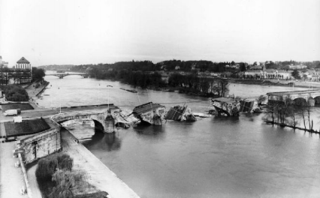
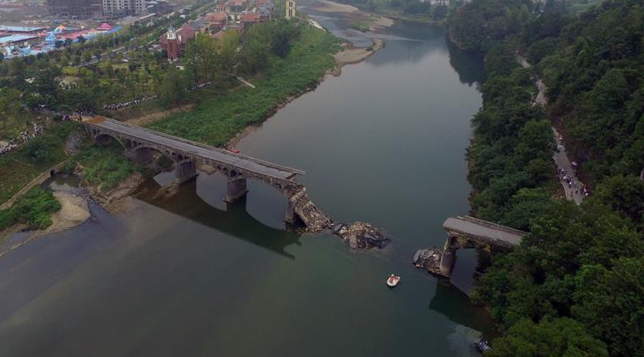
Motivation
Risk of Failure in Bridge
Bridge Name | Nation | Year | Type | Length | Nb of Arches | Cause
Wilson | France | 1978 | Dimension stone | 434 [m] | 15 | Tremendous flood which exceeded the design flood; plus scouring due to running water
Wharfe | UK | 2015 | Magnesian Limestone | 26 [m] | 5
Capilano River | Canada | 1917 | Wood/Concrete | 77 [m] | 4
Xiushui County | China | 2016 | Stones | 185 [m] | 8
← Cost:
35 M francs
(~ €18,4 M)
3 deaths ,
2 injuries →
Wilson Bridge, Tours (1978, France)
Xiushui County Bridge (2016, China)

Slide 5
Problem Statement
& Model

Slide 6

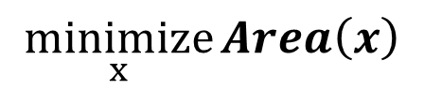
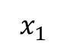
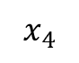
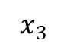
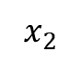
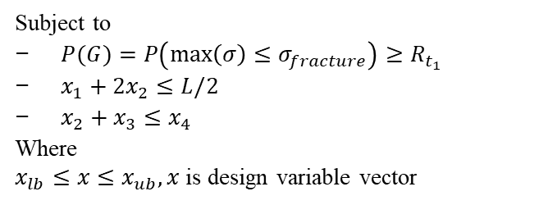
Problem Statement & Model
Problem Statement and Model
L
$$\underset{x}{minimize}{Area\left(x\right)}$$
$$x_{4}$$
Subject to
$P(G)=P\left(\max\left(σ\right)≤σ_{fracture}\right)≥R_{t_{1}}$
$x_{1}+2x_{2}≤L/2$
$x_{2}+x_{3}≤x_{4}$
Where
$x_{lb}≤x{≤x}_{ub}, x$ is design variable vector
$$x_{3}$$
$$x_{1}$$
$$x_{2}$$

Slide 7
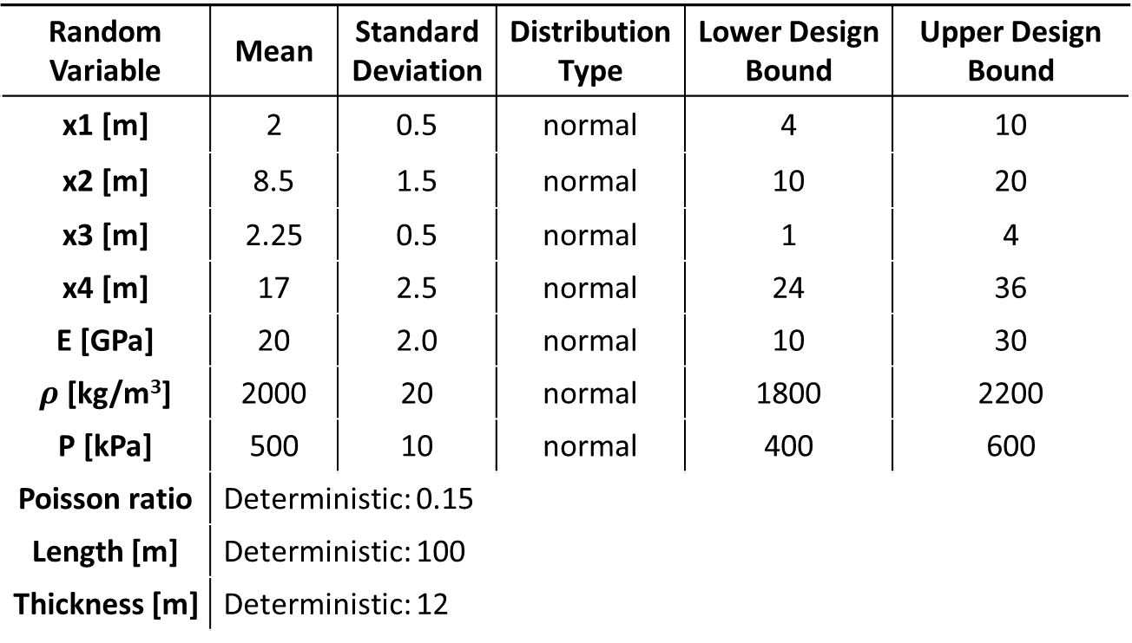
Problem Statement & Model
Random Variables
Random Variable | Mean | Standard Deviation | Distribution Type | Lower Design Bound | Upper Design Bound
x1 [m] | 2 | 0.5 | normal | 4 | 10
x2 [m] | 8.5 | 1.5 | normal | 10 | 20
x3 [m] | 2.25 | 0.5 | normal | 1 | 4
x4 [m] | 17 | 2.5 | normal | 24 | 36
E [GPa] | 20 | 2.0 | normal | 10 | 30
$ρ$ [kg/m³] | 2000 | 20 | normal | 1800 | 2200
P [kPa] | 500 | 10 | normal | 400 | 600
Poisson ratio | Deterministic: 0.15
Length [m] | Deterministic: 100
Thickness [m] | Deterministic: 12
L
$$x_{4}$$
$$x_{3}$$
$$x_{1}$$
$$x_{2}$$

Slide 8
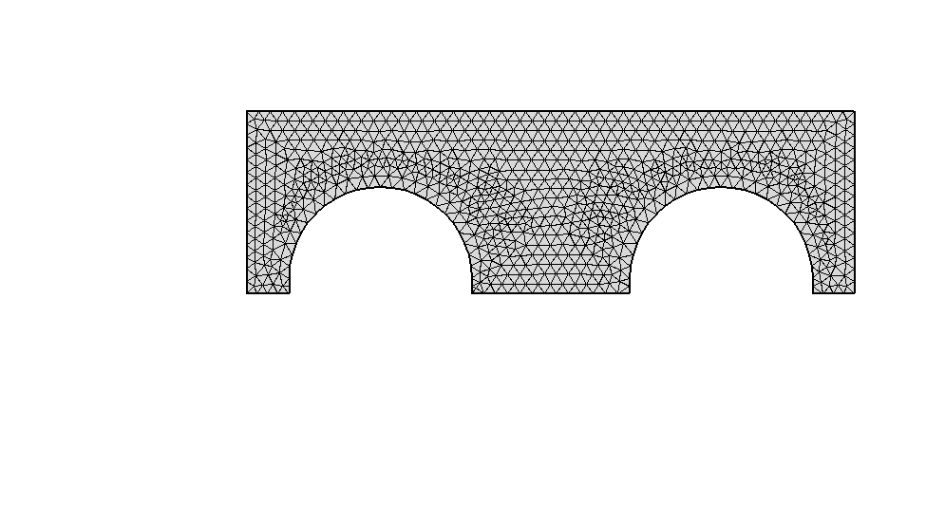
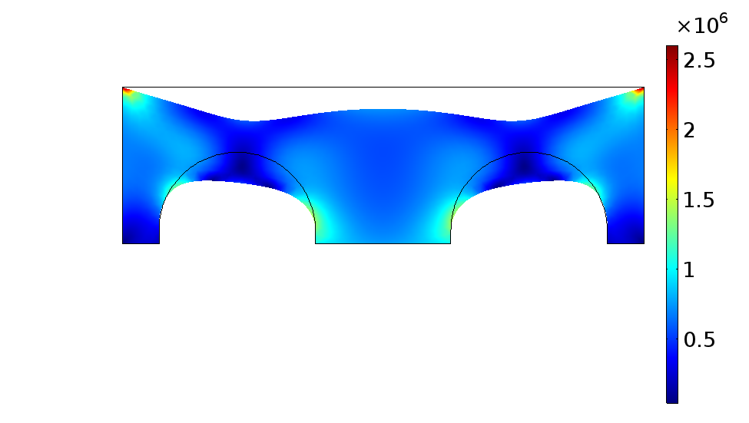
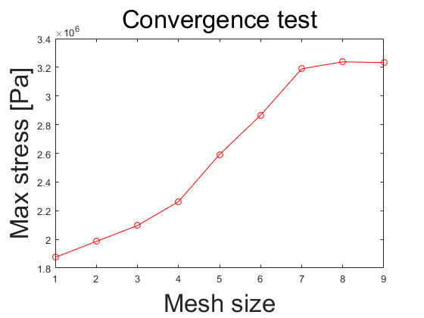
Problem Statement & Model
COMSOL Convergence Test
Reviewing the Project
Mesh Information:
Mesh Size: about 1 [m]
DoF: 8076
Analysis Time: 3 [sec]
The fixed constraints: both sides & three bottom edges.
coarser
finer

Slide 9
Design Optimization

Slide 10
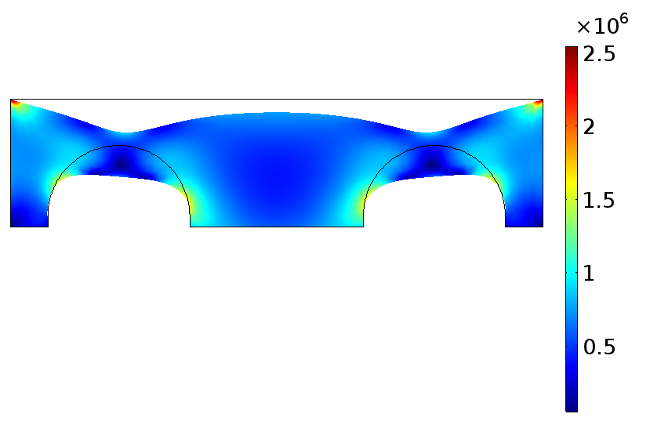
Design Optimization
Design Optimization Result
Design Variables | Initial | Optimum
x1 [m] | 7 | 7
x2 [m] | 15 | 13.3403
x3 [m] | 2.5 | 2.0021
X4 [m] | 30 | 24
Area [m²] | 2143.14 | 1734.08
Tolerance: 1e-9
Iteration: 8 & F-count: 104
Time: 269.793[sec]
Area deceases 19%

Slide 11
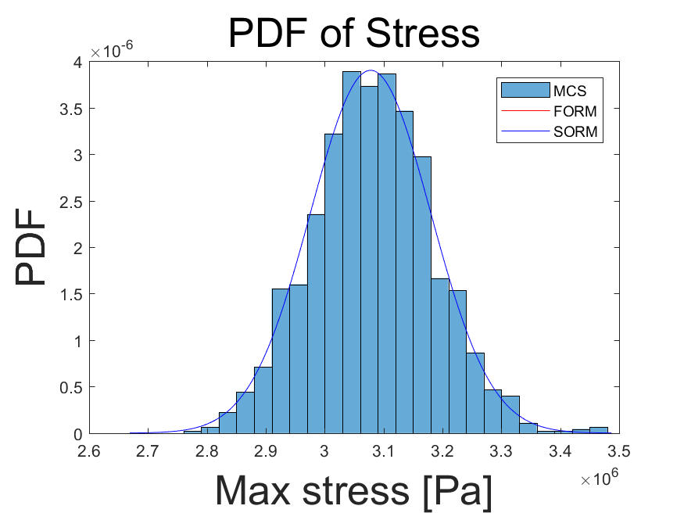
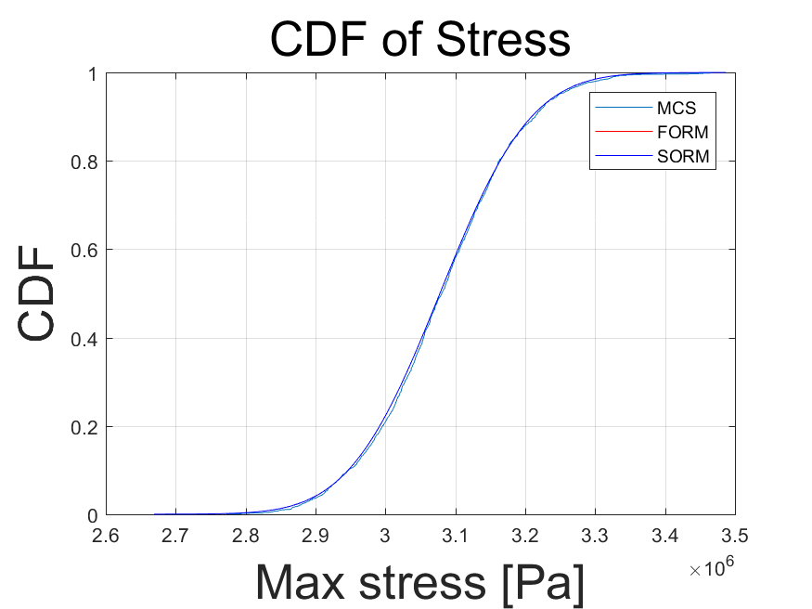
Design Optimization
Reliability of Initial Design Result
PDF & CDF of Maximum Von Mises Stress
Reliability with several methods
Methods | MCS | FORM | SORM | RIA
Maximum Von Mises Stress | 0.2093 | 0.2229 | 0.2229 | 0.2275

Slide 12
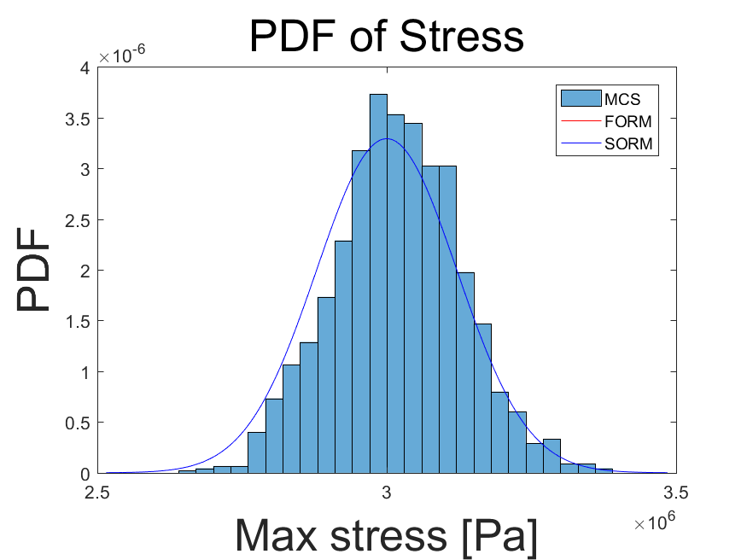
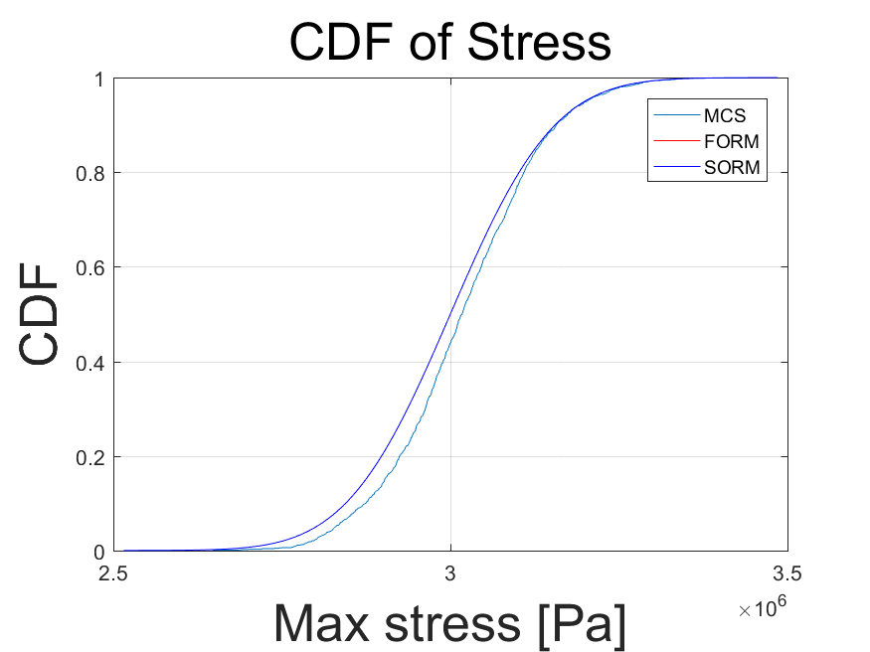
Design Optimization
Reliability of Design Optimization Result
PDF & CDF of Maximum Von Mises Stress
Reliability with several methods
Methods | MCS | FORM | SORM | RIA
Maximum Von Mises Stress | 0.4610 | 0.5000 | 0.5001 | 0.5000

Slide 13
Reliability Based
Design Optimization

Slide 14
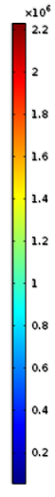
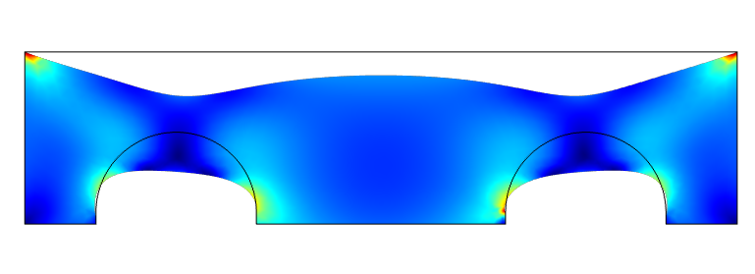
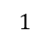
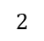
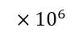
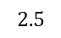
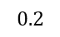
Reliability Based Design Optimization
Reliability Based Design Optimization Result (From Initial Design)
$${×10}^{6}$$
$$2.5$$
$$2$$
$$1$$
$$0.2$$
Design Variables | Initial | RBDO (PMA) | RBDO (RIA)
x1 [m] | 7 | 10 | 10
x2 [m] | 15 | 11.2586 | 11.2342
x3 [m] | 2.5 | 1.6302 | 1.5164
X4 [m] | 30 | 24.1577 | 24.2236
Area [m²] | 2143.14 | 1944.14 | 1957.73

Slide 15
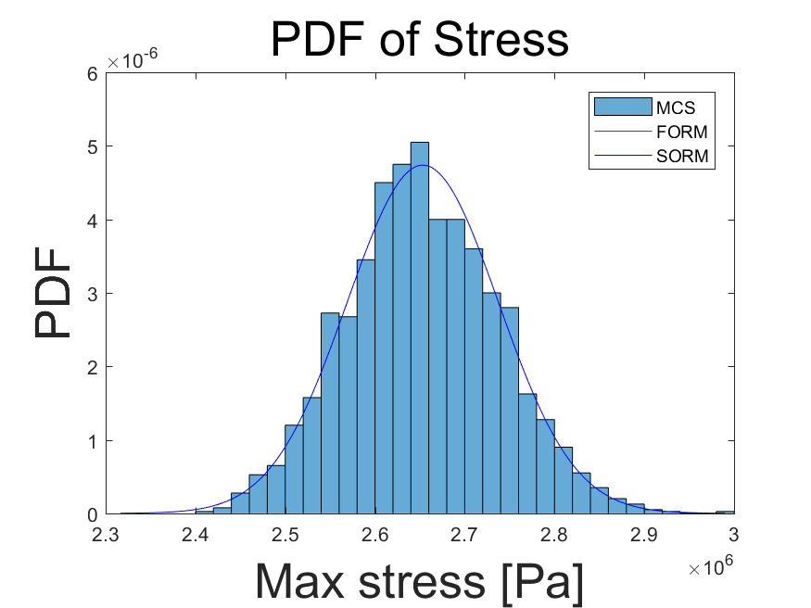
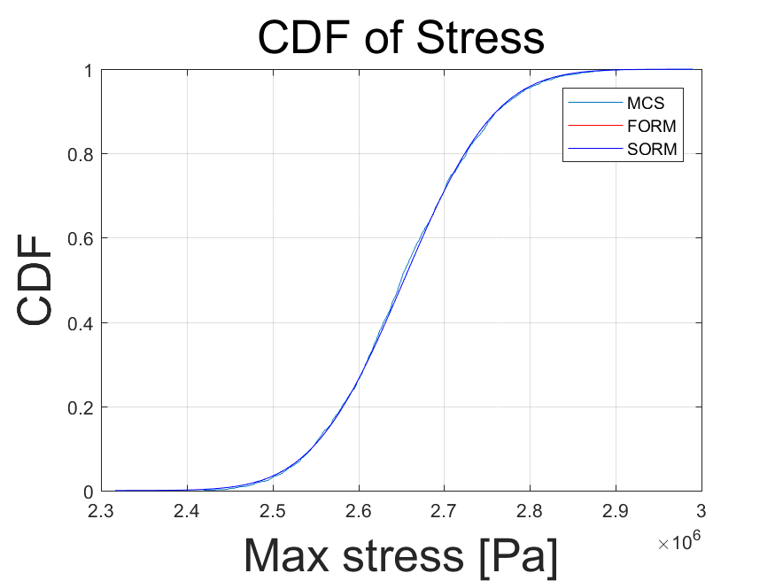
Reliability Based Design Optimization
Reliability of Reliability Based Design Optimization Result-PMA
PDF & CDF of Maximum Von Mises Stress (Starting from Initial Design)
Reliability with several algorithms
Constraint | MCS | FORM | SORM | RIA
Maximum Von Mises Stress | 0.9952 | 0.9901 | 0.9905 | 0.9924

Slide 16
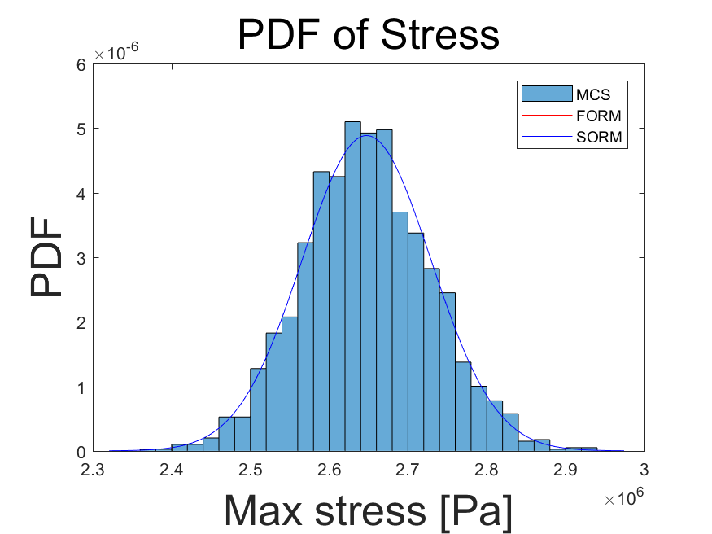
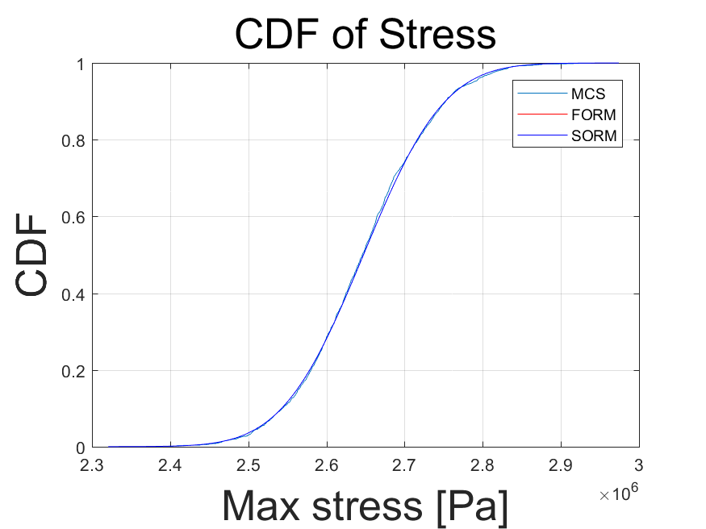
Reliability Based Design Optimization
Reliability of Reliability Based Design Optimization Result-RIA
PDF & CDF of Maximum Von Mises Stress (Starting from Initial Design)
Reliability with several algorithms
Constraint | MCS | FORM | SORM | RIA
Maximum Von Mises Stress | 0.9963 | 0.9919 | 0.9920 | 0.9922

Slide 17
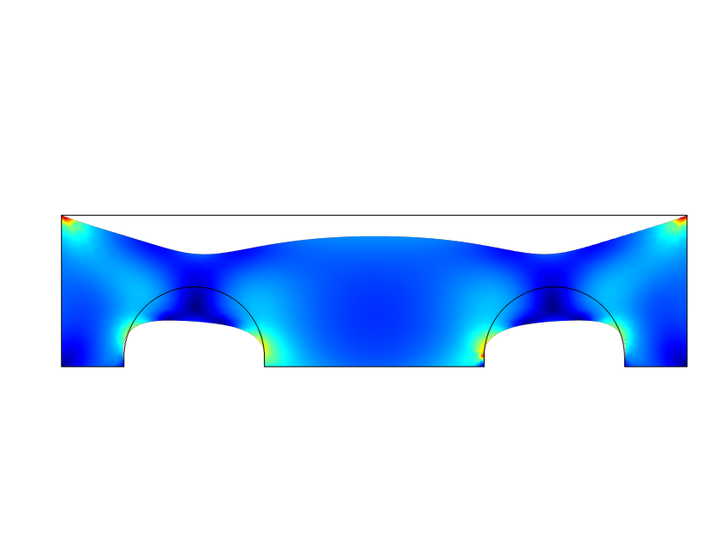
Reliability Based Design Optimization
Reliability Based Design Optimization Result (From DDO)
$${×10}^{6}$$
$$2.5$$
$$2$$
$$1$$
$$0.2$$
Design Variables | DDO | RBDO (PMA) | RBDO (RIA)
x1 [m] | 7 | 10 | 10
x2 [m] | 13.3403 | 11.2201 | 11.2152
x3 [m] | 2.0021 | 1.5302 | 1.5264
X4 [m] | 24 | 24.1868 | 24.2108
Area [m²] | 1734.07 | 1954.51 | 1957.45
Notes:
Tolerance: 1e-9
Iteration: 7
F-count: 111
Time (PMA): 18.3 [hr]

Slide 18
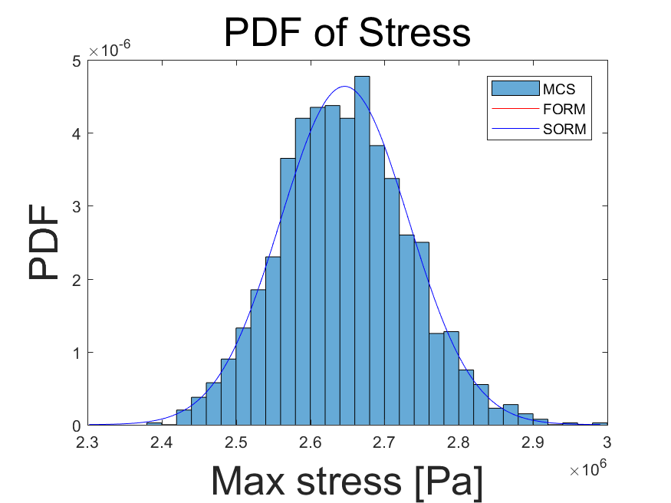
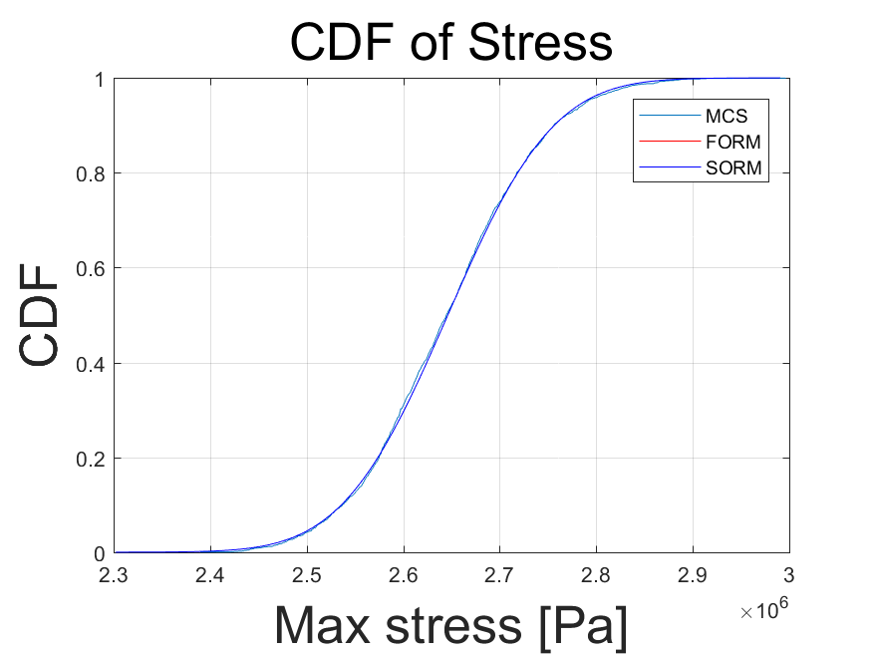
Reliability Based Design Optimization
Reliability of Reliability Based Design Optimization Result-PMA
PDF & CDF of Maximum Von Mises Stress (Starting from DDO)
Reliability with several algorithms
Constraint | MCS | FORM | SORM | RIA
Maximum Von Mises Stress | 0.9926 | 0.9913 | 0.9914 | 0.9958

Slide 19
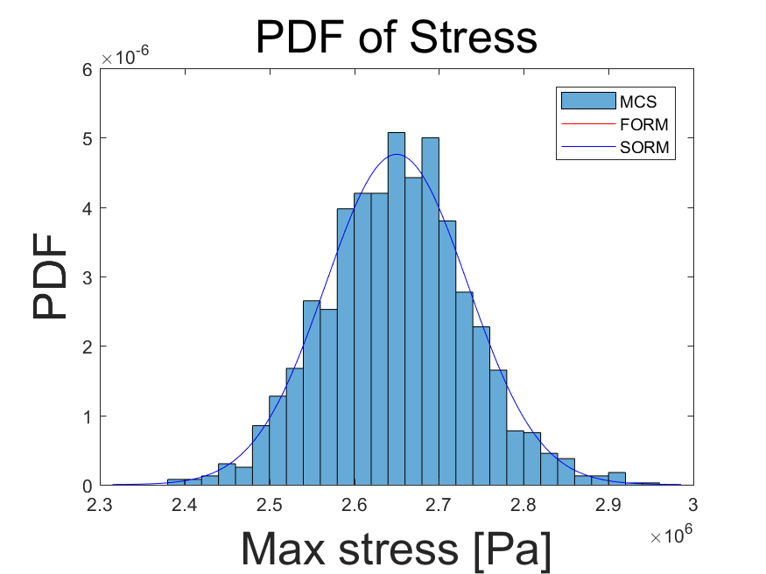
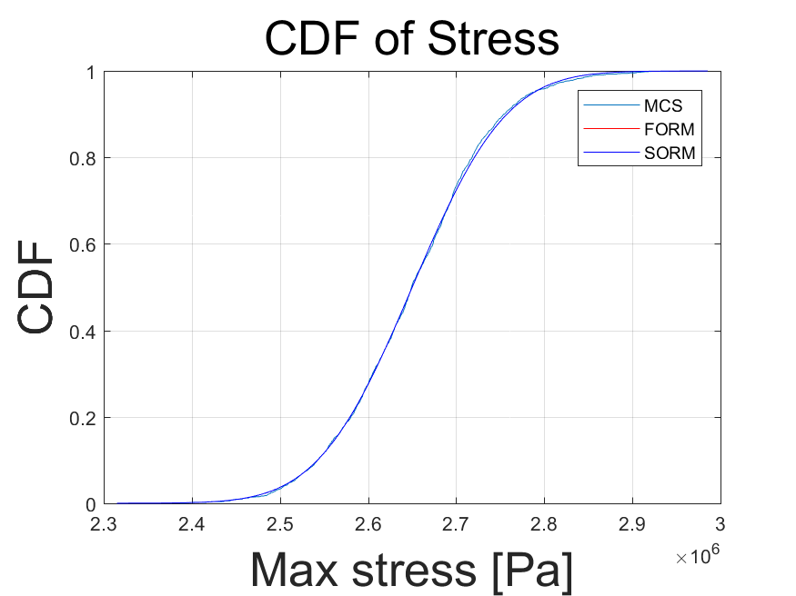
Reliability Based Design Optimization
Reliability of Reliability Based Design Optimization Result-RIA
PDF & CDF of Maximum Von Mises Stress (Starting from DDO)
Reliability with several algorithms
Constraint | MCS | FORM | SORM | RIA
Maximum Von Mises Stress | 0.9964 | 0.9939 | 0.9942 | 0.9935

Slide 20
Sensitivity Analysis

Slide 21
Sensitivity Analysis
Sensitivity Analysis for RBDO results
Maximum Von Mises Stress
Random variables | x1 [m] | x2 [m] | x3 [m] | x4 [m]
PMA (Initial) | 0.1682 | -0.7126 | -0.1716 | 0.0006
RIA (Initial) | 0.1458 | -0.3731 | -0.1075 | 1.0804
PMA (DDO) | -0.4560 | -1.0141 | -0.3467 | 0.1998
RIA (DDO) | 0.1564 | -0/6714 | -0.6543 | 0.4384
positive
(except 3th)
negative
negative
positive
L
As x4 increases, Reliability increases
As x2, x3 increase, Reliability decreases
$$x_{4}$$
$$x_{3}$$
$$x_{1}$$
$$x_{2}$$

